Slide 1


Slide 2
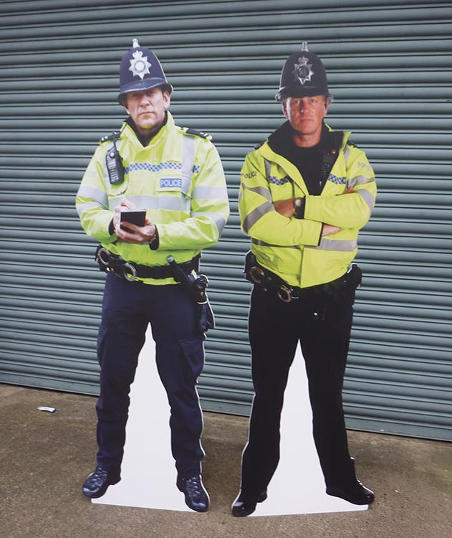



Disclaimer
Don’t do illegal shit

Slide 3
What is a SOC?
Security Operations Center
A team that focuses on responding to cyber security threats. This includes:
Monitoring
Detecting
Investigating
Responding
Threat hunting

Slide 4

Monitoring
Definition - continuously observing what is happening
Physical security:
CCTV
Keycards
Network monitoring:
Depends on what tools are being used
Checking alerts
Monitoring traffic

Slide 5

Detecting
Definition - identifying threats or suspicious activity and responding to them
Includes:
Finding suspicious activity
Looking into alert
Logging a ticket/creating a Security Incident Response

Slide 6

Investigating
Definition - researching into a alert to determine potential damage and how the attack was carried
Includes:
Analysing event logs
Establishing if it is malicious activity
Gathering information, such as IP, eventtime
Google is your best friend!

Slide 7
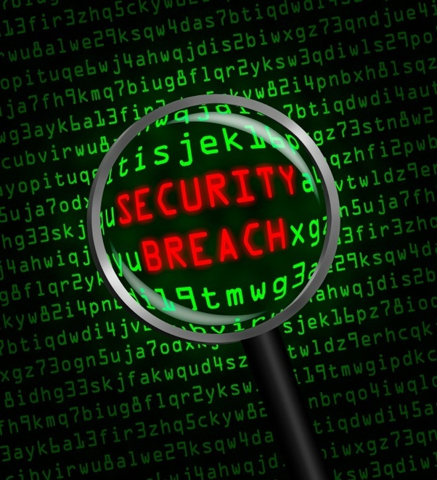
Responding
Definition - taking actions to stop any further damage
Includes:
Containment
Preventing malicious activity from spreading
Blocking IPs or Containing devices
Eradication
eliminating the cause of the attack
Patching vulnerabilities
Recovery
Restoring back-ups

Slide 8


Threat Hunting
Definition - when you assume that a hacker has already infiltrated a system and plan what steps to prevent or contain this
Includes:
Responding to attack before it happens
‘Feedly’ - apply top cyber security news outlets to it
Checking the system for vulnerabilities
Editing code to patch vulnerabilities

Slide 9
Types of SOCs
Internal - business uses their own cyber security team
Virtual - a SOC that works remotely without a physical facility
Global - a group that oversees several other SOCs
Co-managed - company’s internal cyber security team working with an outside vendor

Slide 10
SOC Structure
Tier 1
Tier 2
Tier 3

Slide 11
Tier 1
Tier 1 analysts typically have little to no experience
Analyst focus on:
Monitoring for suspicious activity
Checking event logs
Alerts
Gathering information for suspicious activity
Time of the event
IP address
Potential vulnerability threat actor used
Analyst will then escalate incident to more experienced tier 2 analyst

Slide 12
Tier 2
Tier 2 analysts usually have a few years of experience
Analyst focuses on:
Investigating incidents raised by tier 1
Assess the damage
Determine extent the threat actor was able to access
Remediation
If data was stolen or damage
For example, rewriting code

Slide 13
Tier 3
Tier 3 analysts are the most experienced
Analyst focuses:
Threat hunting
Analysing security trends
Patching vulnerabilities before incidents can occur
Monitoring activity in case tier 1 missed suspicious activity
Designing code to counter security trends

Slide 14
Benefits
Protects customer data
Having a SOC work 24/7 better protects a company’s infrastructure
Reduces time of threat detection
Threats are detected faster and triaged effectively
Employees are able to focus on other initiatives

Slide 15

Challenges
Global shortage of cybersecurity professionals
Challenge for SOC’s hiring but perfect for people looking to enter the industry :)
Some SOC’s can get overwhelmed with too many alerts
This depends on the amount of detection tools
A lot of these alerts are false positives
Editing automation

Slide 16
Tools & Technologies
FireEye
Many different types of tools
FireEye endpoint security - focuses on devices employees use
FireEye Helix - cloud security
Google Workspace
Alerts on account warnings, phishing and malware, and device management
Microsoft Azure
Cloud computing

Slide 17
Tools & Technologies
Splunk
Monitors and analyzes machine data
Nemo
Solutions provider
Security training, penetration testing, and consulting
Akamai
Web traffic into user friendly graphs
Have their own SOC as well

Slide 18
Experience
Tier 1
Typical day:
8am - start, complete first checks of the day
9am to 4pm - complete checks hourly. Triage if necessary.
Tier 2
Typical day:
9am - check to see if any incidents were triaged
10am to 5pm - focus on creating and completing SIRs

Slide 19

How to Become a SOC Analyst
CompTIA certificates
PluralSight training
CTF events

Slide 20
Questions?

